Slide 1
Lecture 15 – Data Vis

Slide 2
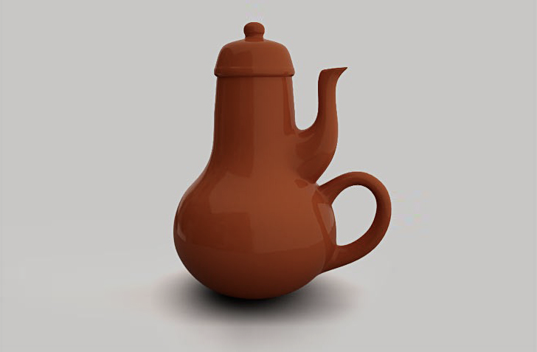
“Everyday people are not very good designers.”
-- Don Norman

Slide 3

“Data is not the thing; Data is about the thing.”
-- some hipster

Slide 4
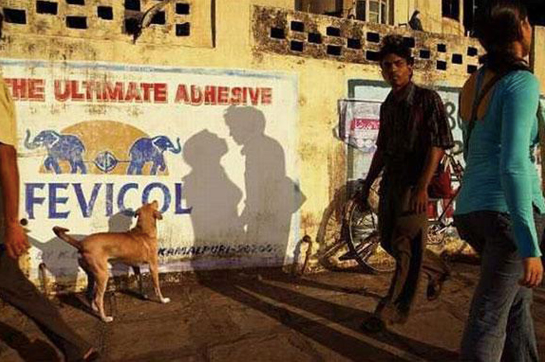

Slide 5
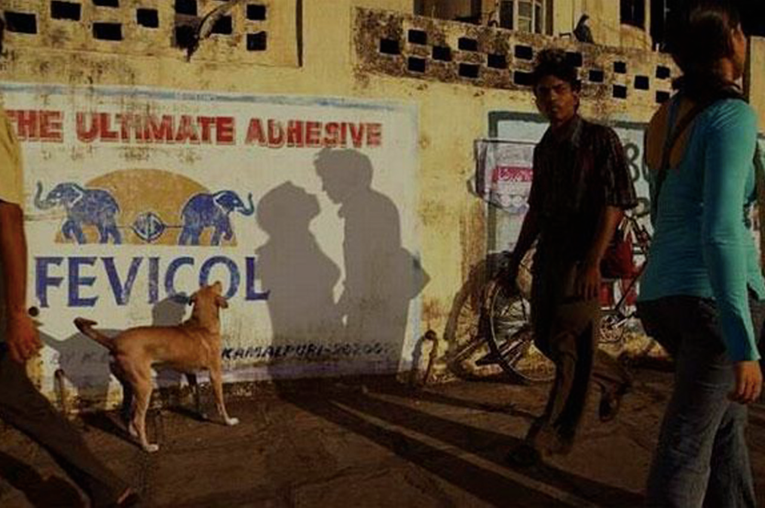
“Data is a Viewpoint”

Slide 6

I shall not use visualization to intentionally hide or confuse the truth which it is intended to portray. I will respect the great power visualization has in garnering wisdom and misleading the uninformed. I accept this responsibility willfully and without reservation, and promise to defend this oath against all enemies, both domestic and foreign.

Slide 7
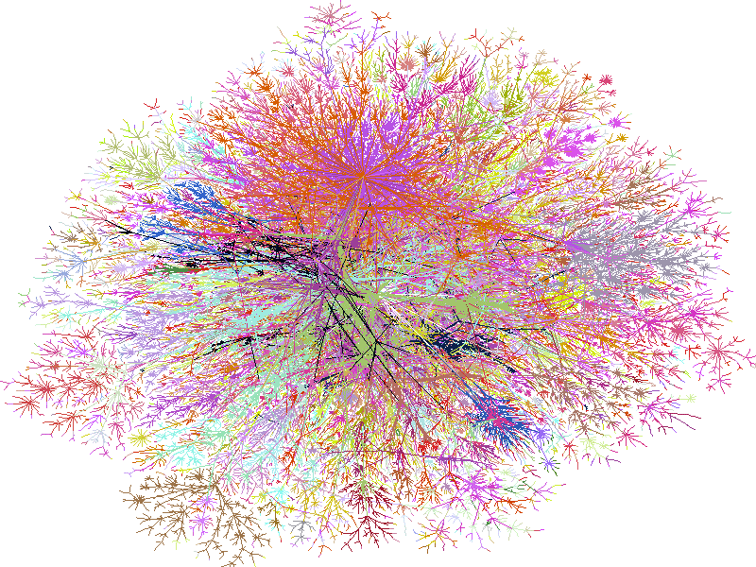
Good Design Reveals Patterns
100,000 computers colored by IP addresses in 1998.

Slide 8
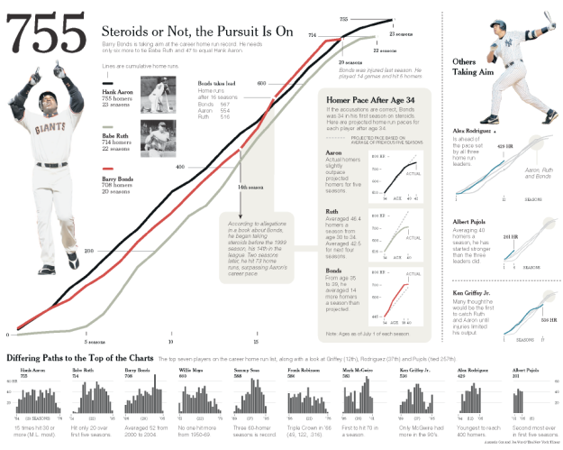

Slide 9
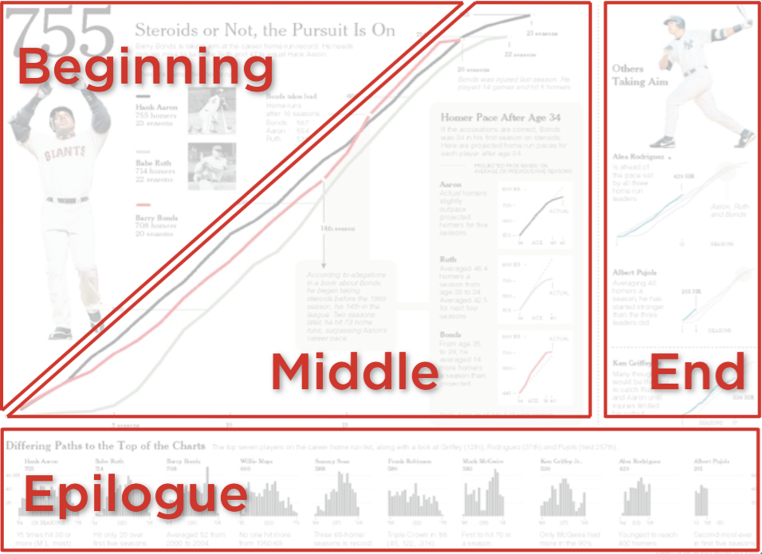
Notes:
(heer)

Slide 10
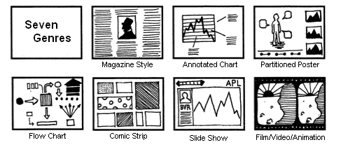
Genres of Visual Storytelling

Slide 11
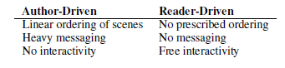
Author-Driven vs. Reader-Driven
Traditionally storytelling falls under the author-driven or reader-driven dichotomy.
Recently, most storytelling (with vis) falls somewhere in between.

Slide 12

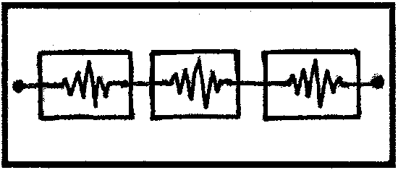
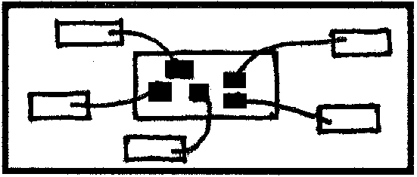
Balancing The Two
Three Common Schemas
Martini Glass
Begins with author-driven, but allows the user to explore in the end.
Interactive Slideshow
Allows the user to explore at particular points of the narrative.
Drill-Down Story
Allows the user to choose his own story of interest by selecting from an overview.

Slide 13
Connecting Data To Visualization
Data have attributes (dimensions)
Visualizations have attributes (dimensions)
Can the two map to each other?
Jacques Bertin, Semiologie Graphique (Semiology of Graphcis), 1967.

Slide 14

Elements of Visualization
Images are composed of marks: “ink”, graphical primitives

Slide 15
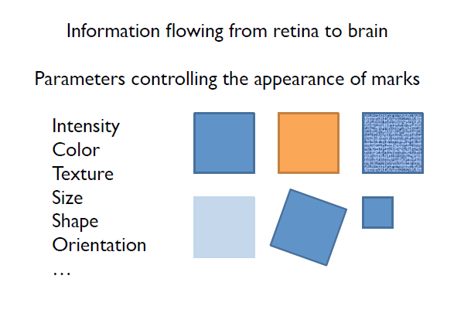
Visual Channels

Slide 16
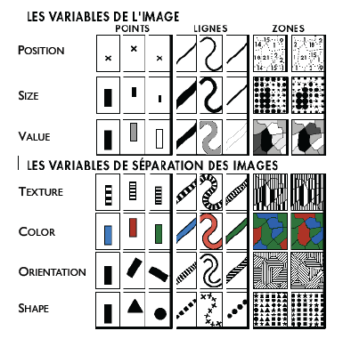
Elements of Visualization
Bertin, 1967

Slide 17
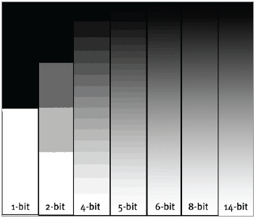
Value (Intensity)
Discrete or Continuous?
Bertin, 1967

Slide 18
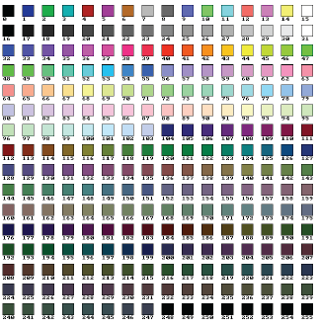
Color (Hue)
Discrete or Continuous?
Bertin, 1967

Slide 19
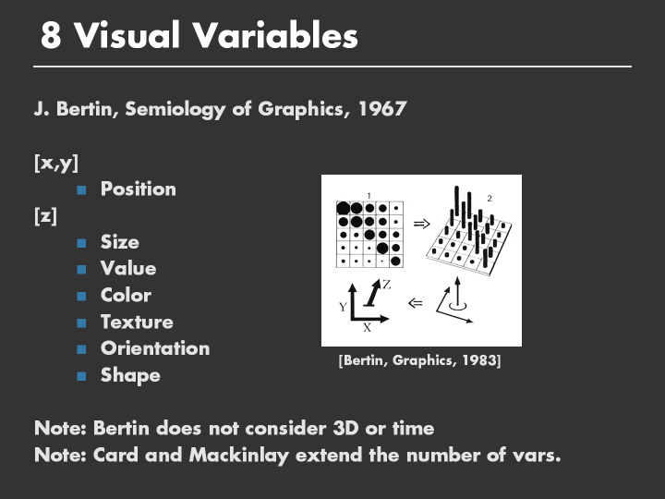

Slide 20
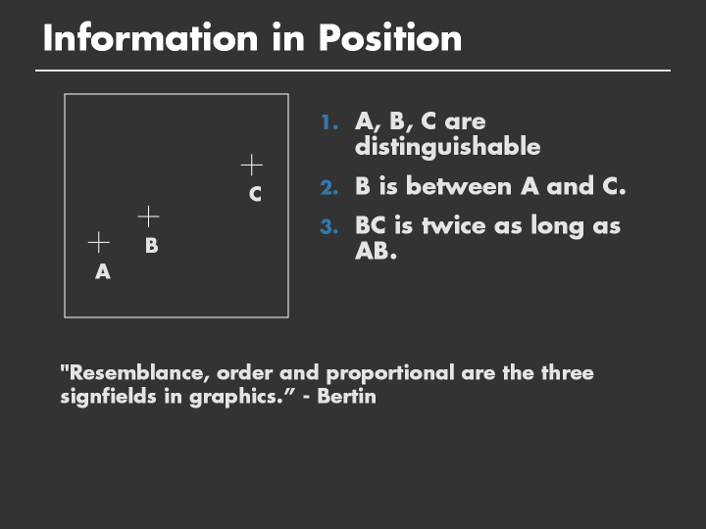

Slide 21
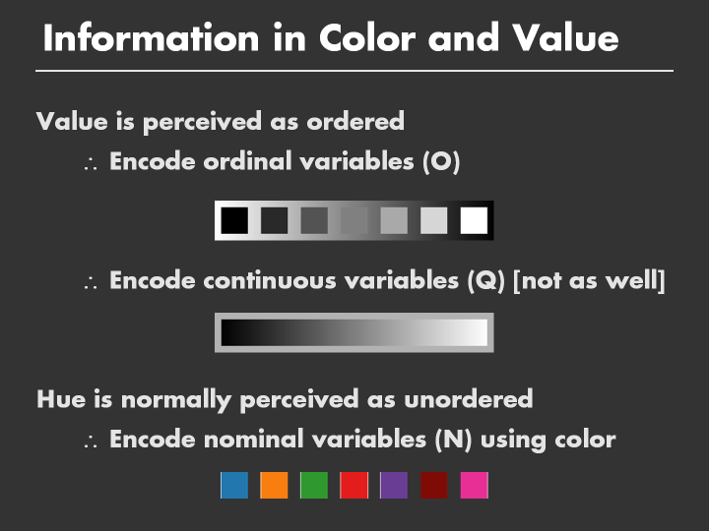

Slide 22
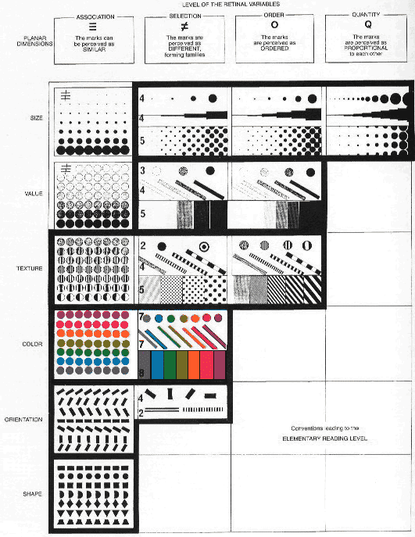
Bertin, 1967

Slide 23
End Part 1

Slide 24
Edward Tufte
“The Visual Display of Quantitative Information”
Self-published book
Evangelist for good visual design
Most designs are static, but many principles apply to interactive (computer-based) visualization designs
Take these design guidelines with a grain of salt

Slide 25
Edward Tufte
Lie Factor
Data Ink Ratio
Graphical Excellence

Slide 26
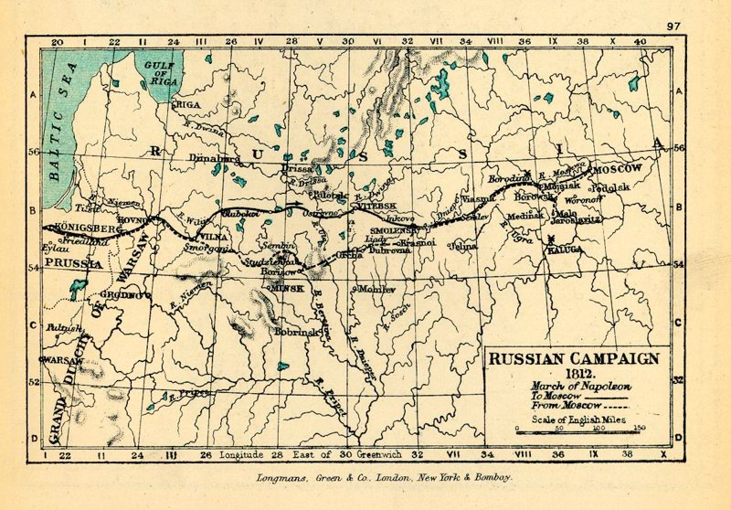
Napoleon’s March to Moscow

Slide 27
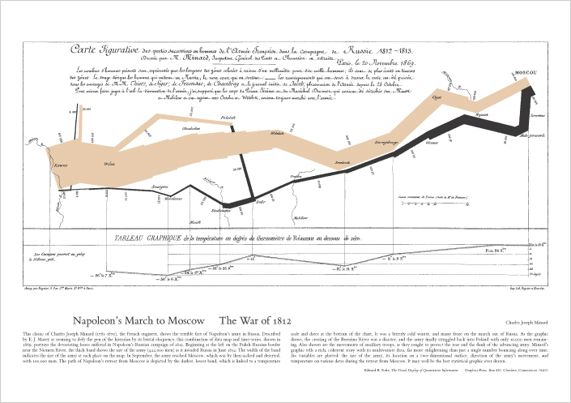
Minard’s Map of Napoleon’s March to Moscow
Notes:
6 variables
Date/time
Troop location
Troop direction
Temperature
Troop size
Type of troop movement (attack/retreat)

Slide 28
Graphical Integrity
“Above all else show the data”

Slide 29
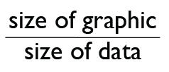
The Lie Factor
Tufte coined the term “the lie factor”, which is defined as:
Lie_factor =
“High” lie factor (LF) leads to:
Exaggeration of differences or similarities
Deception
Misinterpretation

Slide 30
The Lie Factor
The Lie Factor (LF) can be
LF > 1
LF < 1
If LF is > 1, then size of graphic is greater than the size of data
This leads to exaggeration of the data (overstating the data)
If LF < 1, then the size of the data is greater than the graphic
This leads to hiding the data (understating the data)

Slide 31
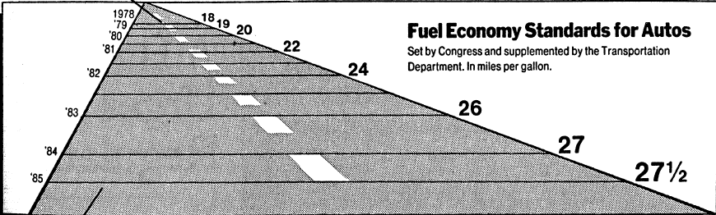
What’s Wrong With This?
US Department of Transportation had set a series of fuel economy standards to be met by automobile manufacturers, beginning with 18 miles per gallon in 1978 and moving in steps up to 27.5 by 1985.

Slide 32
What’s Wrong With This?
This line represents 18 miles per gallon in 1976, is 0.6 inches long
This line represents 27.5 miles per gallon in 1985, is 5.3 inches long

Slide 33
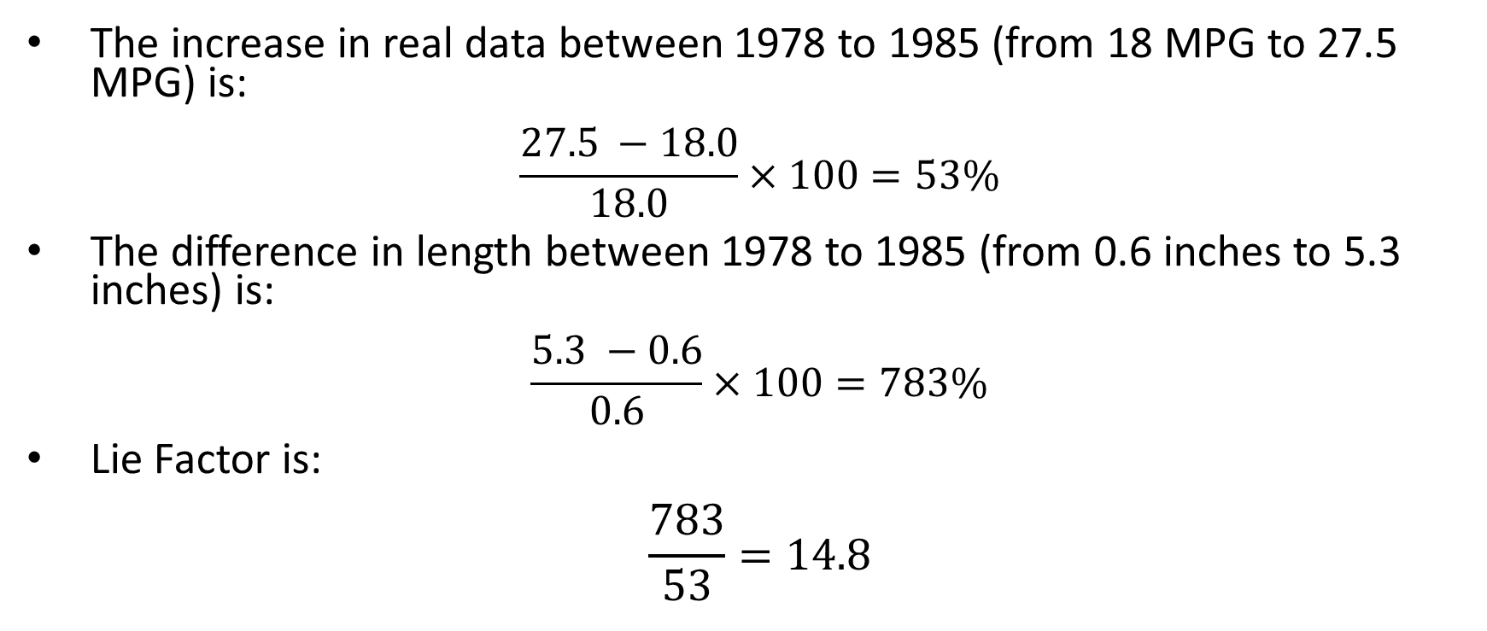
What’s Wrong With This?
The increase in real data between 1978 to 1985 (from 18 MPG to 27.5 MPG) is:
$$\frac{27.5 −18.0}{18.0}×100=53\%$$
The difference in length between 1978 to 1985 (from 0.6 inches to 5.3 inches) is:
$$\frac{5.3 −0.6}{0.6}×100=783\%$$
Lie Factor is:
$$\frac{783}{53}=14.8$$

Slide 34
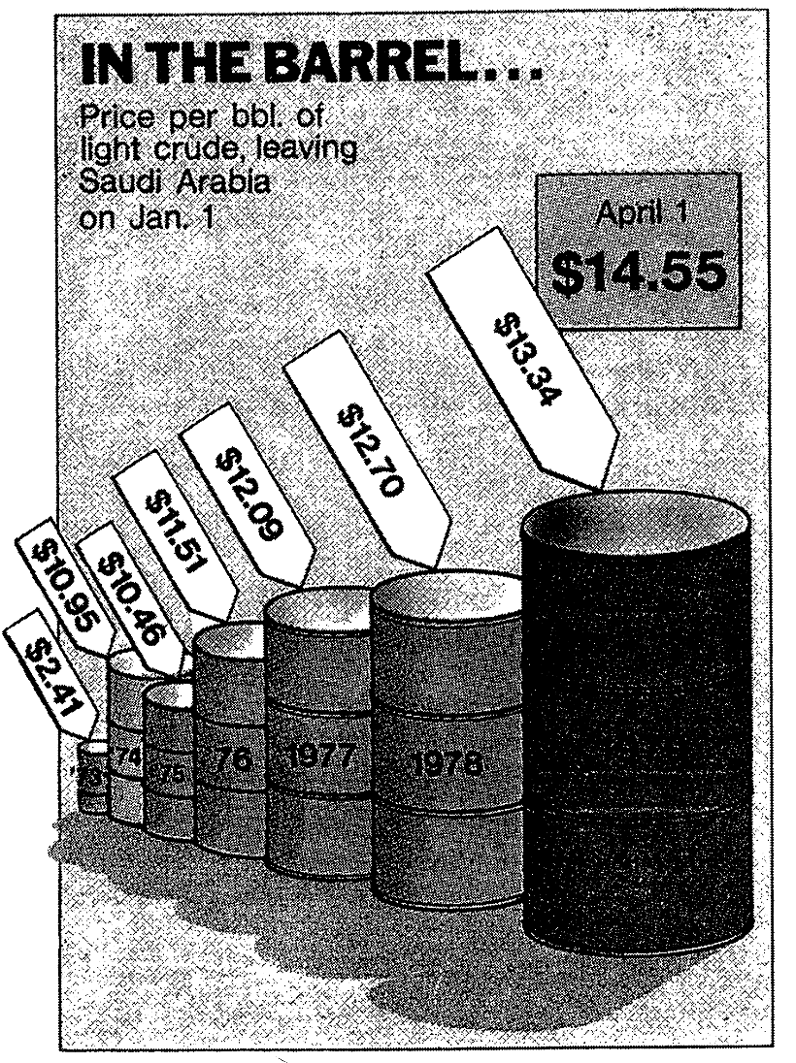
Similarly
This design contains a lie factor of 9.4

Slide 35
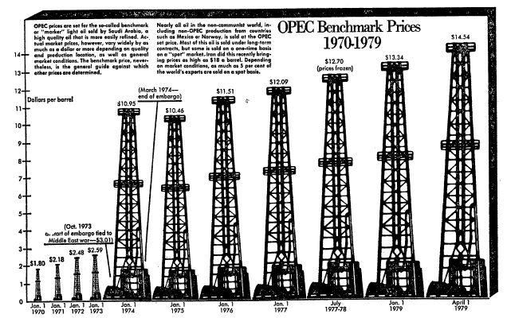
Similarly
This design contains a lie factor of 9.5

Slide 36
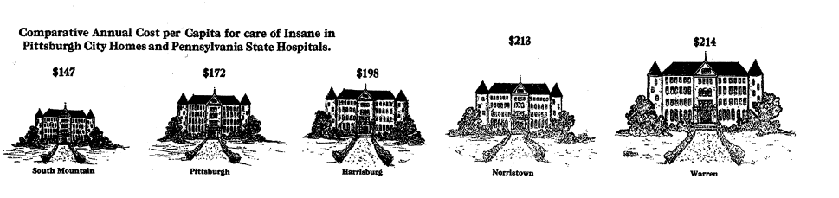
Other Ways To Lie (with the encoding)
Notes:
Note the size of the last two

Slide 37
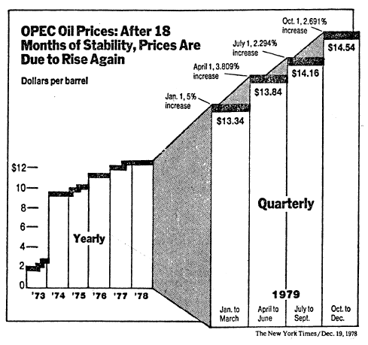
Other Ways To Lie (with the design variation)

Slide 38
Other Ways To Lie (with the design variation)
Beware of the “3D” effect. It distorts the telling of the data.
There are five vertical scales here:
1073-1978:
1 inch = $8.00
Jan-Mar:
1 inch = $4.73
Apr – Jun
1 inch = $4.37
Jul – Sep
1 inch = $4.16
Oct – Dec
1 inch = $3.92
And two horizontal scales:
1973-1978:
1 inch = 3.8 years
1979
1 inch = 0.57 years

Slide 39
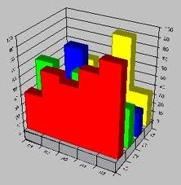
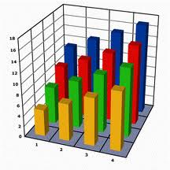
Other Ways To Lie (with the design variation)
The 3D chart capability in Excel:

Slide 40
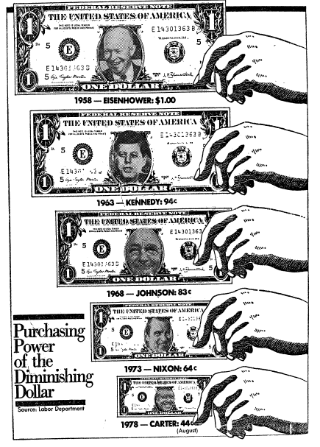
Other Ways To Lie (with double-encoding, e.g. size)
Here, both width and height encode the same information. The effect is multiplicative.
0.44 (width) * 0.44 (height) = 0.19

Slide 41
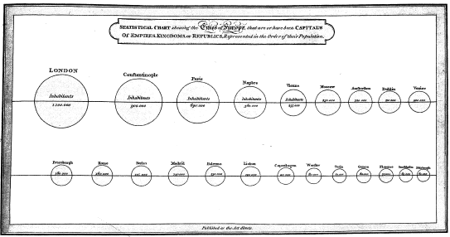
Other Ways To Lie (with unintended encoding)
Notes:
One dimensional data represented by a 2-dimensional measurement (area)

Slide 42
Other Ways To Lie (with unintended encoding)
Are we encoding height, area, or volume?

Slide 43
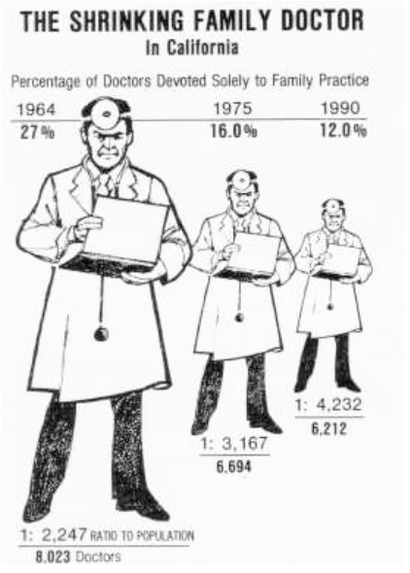
Other Ways To Lie (with alignment)

Slide 44
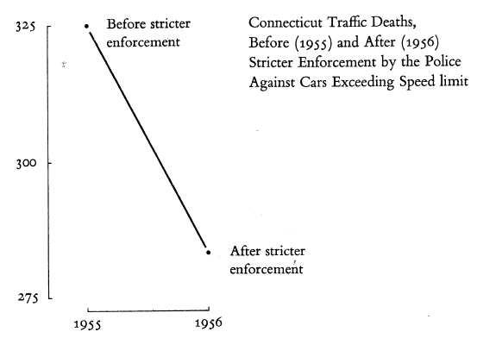
Other Ways To Lie (with limited context)

Slide 45
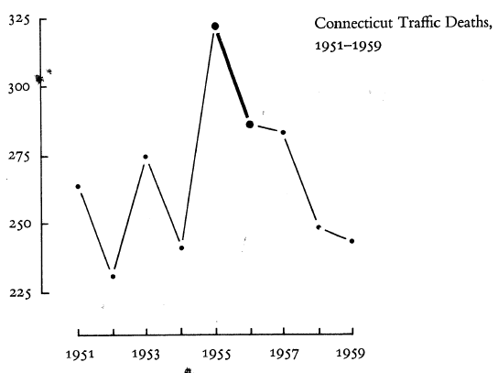
Other Ways To Lie (with limited context)

Slide 46
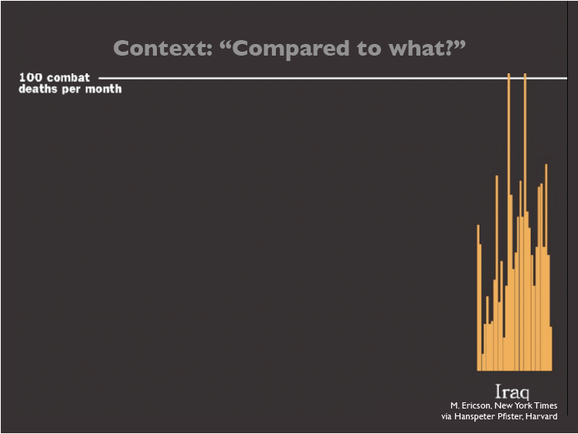
Other Ways To Lie (with limited context)

Slide 47
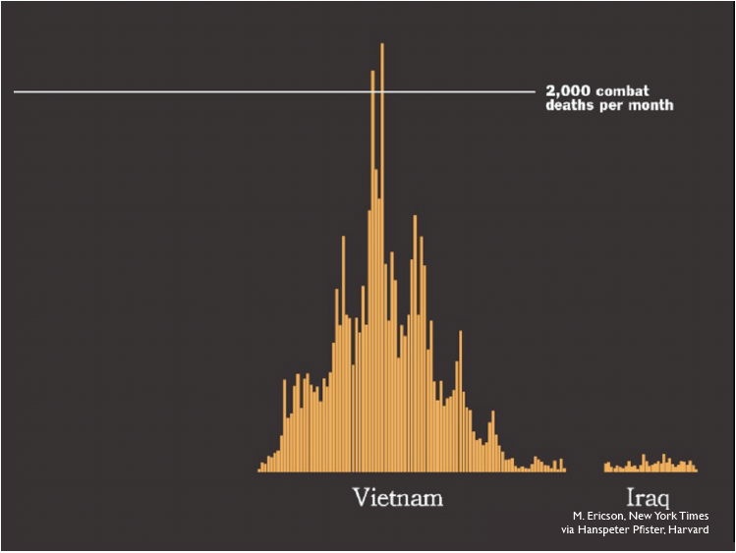
Other Ways To Lie (with limited context)

Slide 48
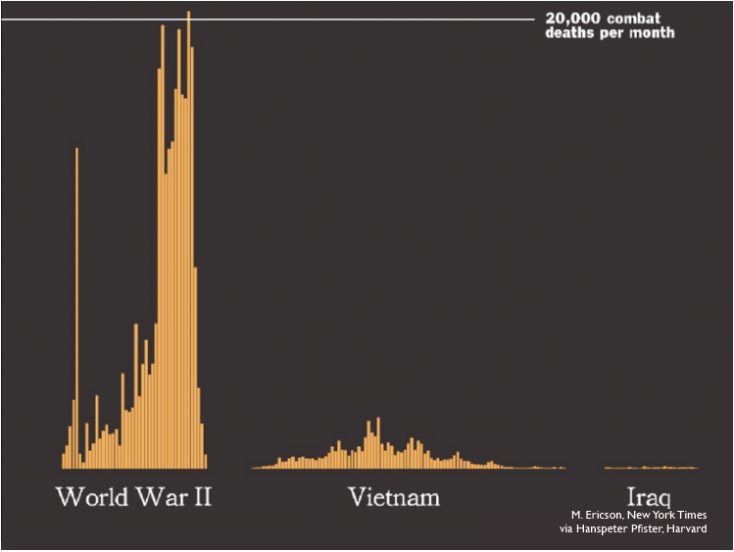
Other Ways To Lie (with limited context)

Slide 49
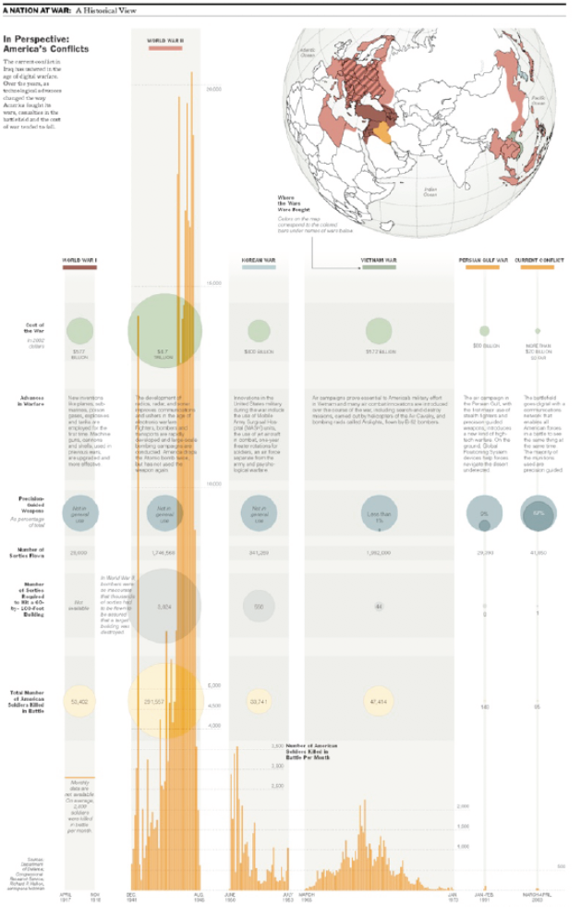
Questions?
Notes:
WWI, WW II, Korean War, Vietnam War, Persian Gulf, Iraq

Slide 50
Data-Ink
“Maximize the Data-Ink Ratio”

Slide 51
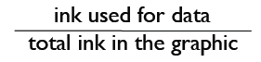
The Concept of Data-Ink Ratio
Data-Ink Ratio =

Slide 52
Data-Ink Ratio
The goal is to aim for high data-ink ratio
Ink used for he data should be relatively large compared to the ink in the entire graphic
Can be thought of as: “proportion of a graphics ink devoted to the non-redundant display of data-information.”
Or, “1.0 – proportion of a graphic that can be erased without loss of data-information.”

Slide 53
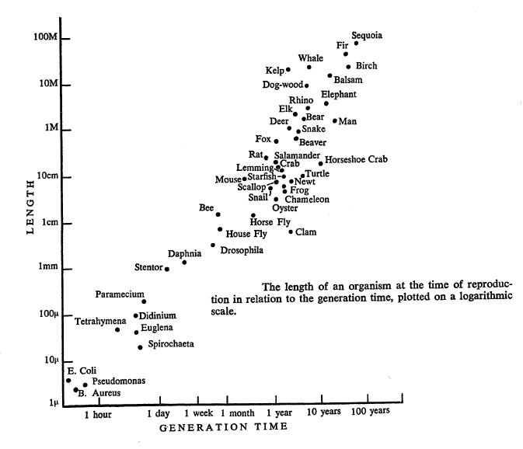
High Data-Ink Ratio Example

Slide 54
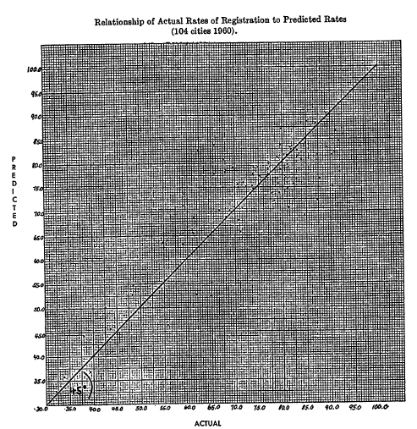
Low Data-Ink Ratio Example

Slide 55
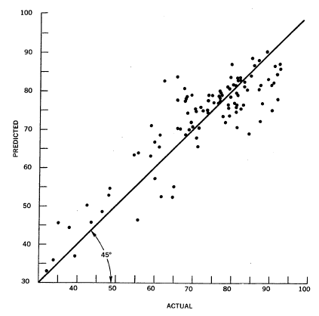
Example Above, Improved
Data-Ink
Ratio of
0.7

Slide 56
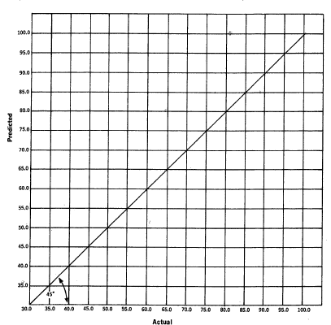
Example Above, Going to Far…
Data-Ink
Ratio of
0.0

Slide 57
“Within Reason”
Maximize the Data-Ink Ratio, within reason.
Erase non-data-ink, within reason.

Slide 58
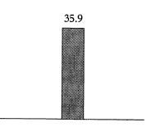
Erasing Non-Data-Ink?
Multiple encodings:
Height of the left line
Height of the right line
Height of shading
Position of top horizontal line
Position (placement) of the number
Value of the number

Slide 59
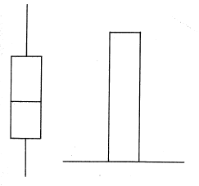
Erasing Non-Data-Ink?
Common statistical graphs

Slide 60
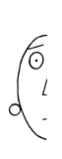
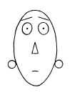
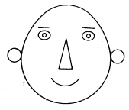

Erasing Non-Data Ink?
Symmetry has its values…

Slide 61
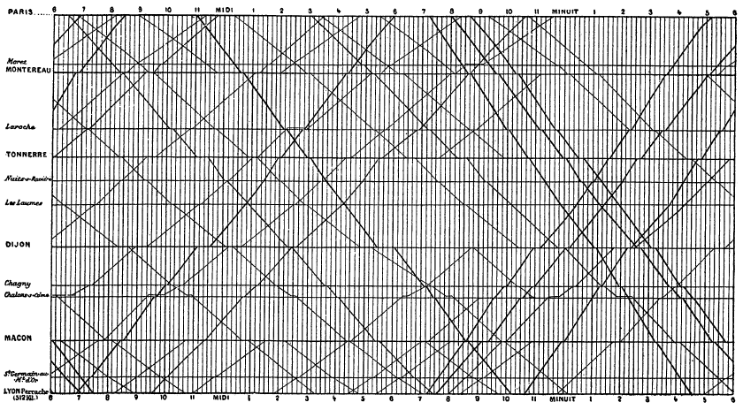
Redundancy
Notes:
Marey’s 1880 Train schedule (France)

Slide 62
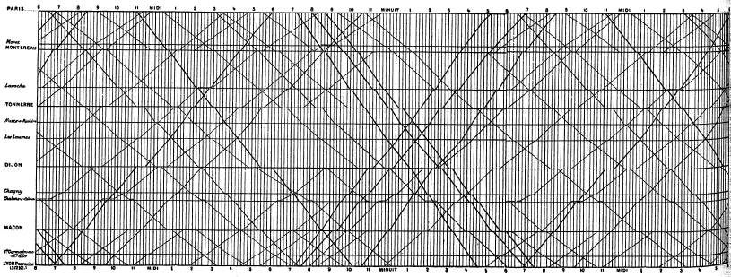
Redundancy
Making the map into a 24 hour cycle adds redundancy, but improves usability

Slide 63

Redundancy
Notes:
The circulation of the World Ocean: A Numerical Study. 1972

Slide 64

Redundancy

Slide 65
Design Principles Based on Data-Ink Ratio
Above all else show the data
Maximize the data-ink ratio
Erase non-data-ink
Erase redundant data-ink
Revise and edit

